Slide 1
Risk and Reward
Lesson 2 - Sustainable Agriculture: Economics

Slide 2
Risks in Agriculture
Internal
On-farm decisions
Available financial inputs
External
Trade markets
Workforce
Mother nature

Slide 3
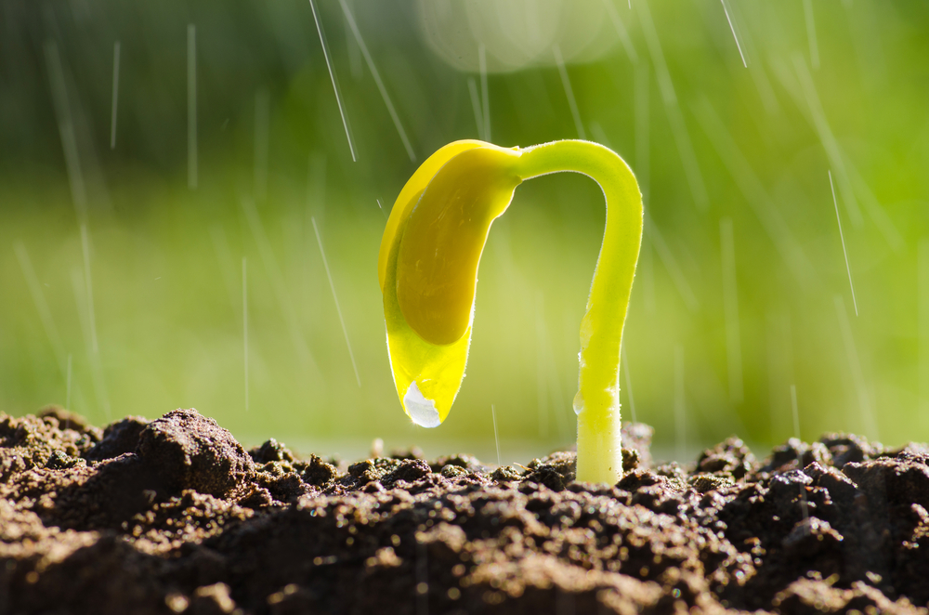
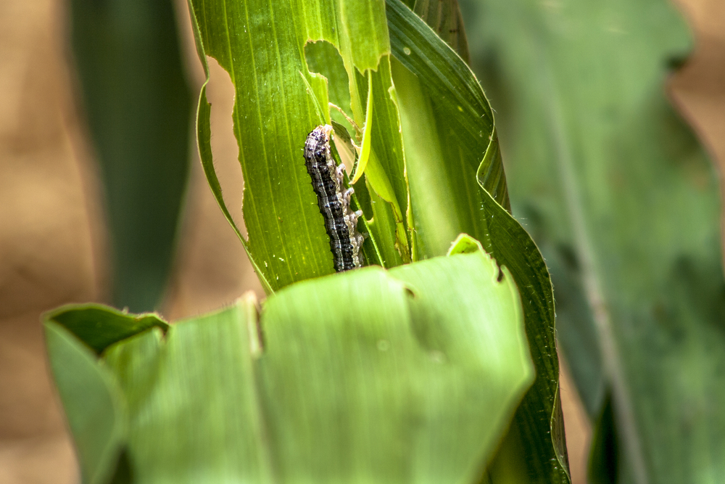
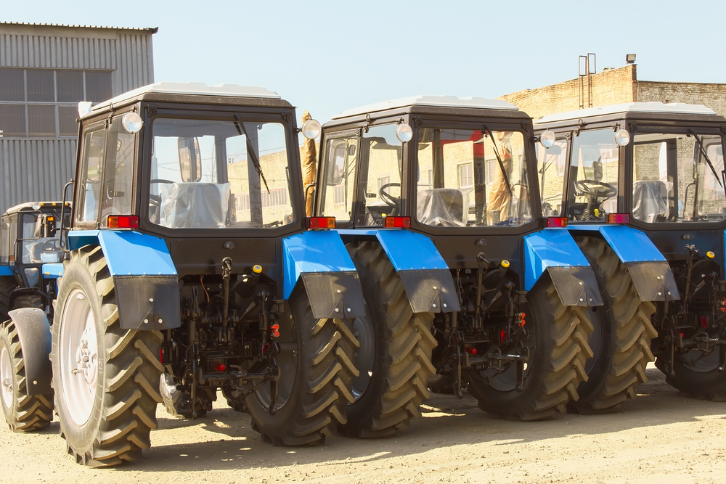
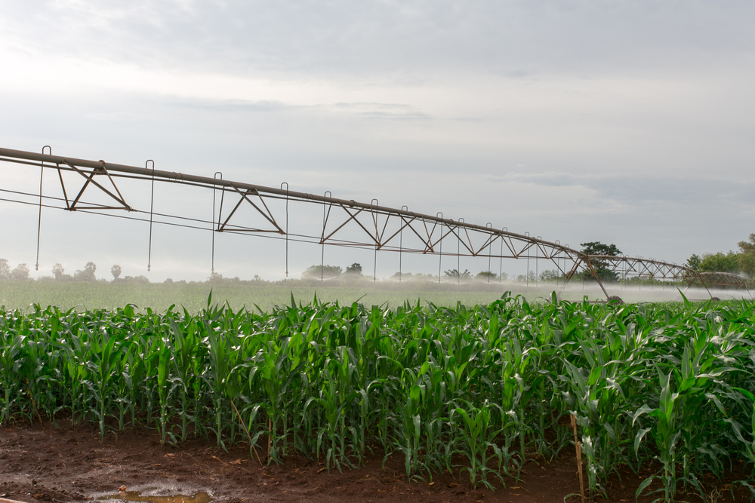
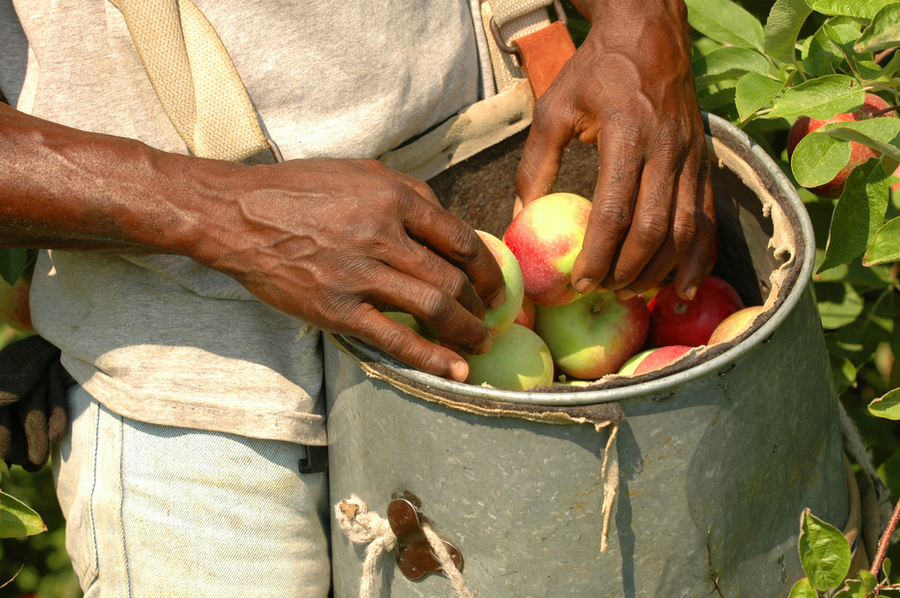
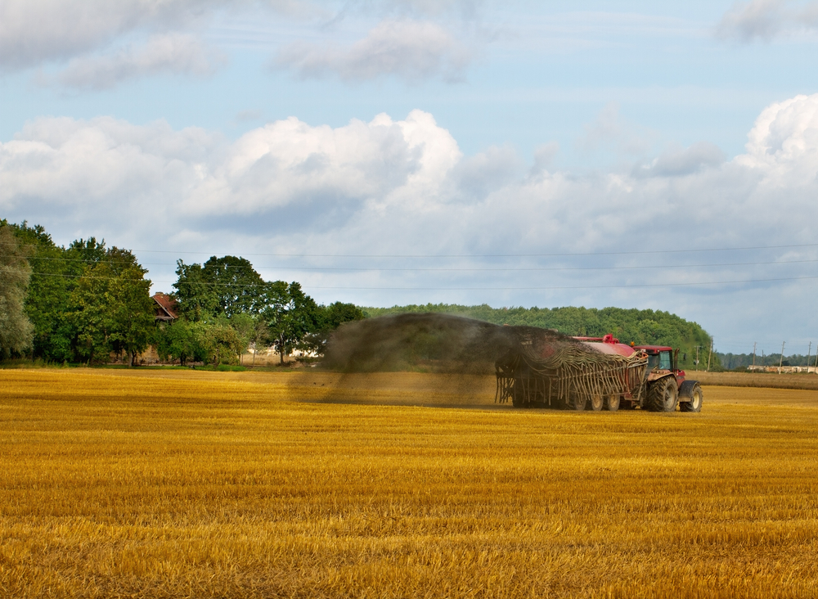
Roll the Die…
1
2
3
4
5
6

Slide 4
Rain, Rain, Go Away!
Back to Home
1
May – October has been full of rainy days, many more than usual! Planting was late due to the wet fields, the corn got a slow start due to the lack of sunny days, and the crop is not faring well overall because it is too wet!
Everyone loses $80 for damage to the crop!
4

Slide 5
Oh No! Bugs!
Back to Home
2
Bugs are in the corn! Did you spray for pests?
YES: Your crop is ok. No loss.
NO: Your crop is severely damaged. Lose $80 for damage to the crop.

Slide 6
Tractor Problems …
Back to Home
3
Your tractor keeps breaking down throughout the season. It’s in and out of the shop with some major repairs!
Everyone loses $40 for tractor repairs.
6

Slide 7
It’s a Dry, Dry Season
Back to Home
4
The ground is hard as rocks due to lack of rain. The corn needs water! Did you irrigate?
YES: Your crop is ok. No loss.
NO: Your crop is severely damaged. Lose $80 for damage to the crop.
3

Slide 8
Help Wanted!
Back to Home
5
You’ve had a hard time hiring extra help to maintain the farm and crop. You finally decide to use migrant labor through the H2A Program.
Everyone loses $60 for additional labor costs.
6

Slide 9
Harvest Time!
Back to Home
6
Time to see how your use of fertilizer paid off! Did you fertilize?
YES: Your corn crop got 200 bushels to the acre! Nice job! At $3.80/bushel for corn, you get $760 dollars. Here’s your check!
NO: Your corn crop got 120 bushels to the acre. At $3.80/bushel for corn, you get $456 dollars. Here’s your check!
6

